Slide 1




Bilsthorpe Flying High Academy
Parent Introduction

Slide 2


Meet the Team…
Hi, I’m Ms Hinton, a Thrive Practitioner and Family Thrive Lead.
My favourite Thrive activity is getting messy with shaving foam!
Hi, I’m Mrs Carlin, Thrive Practitioner and Classroom Teacher.
My favourite Thrive activity is story telling.

Slide 3
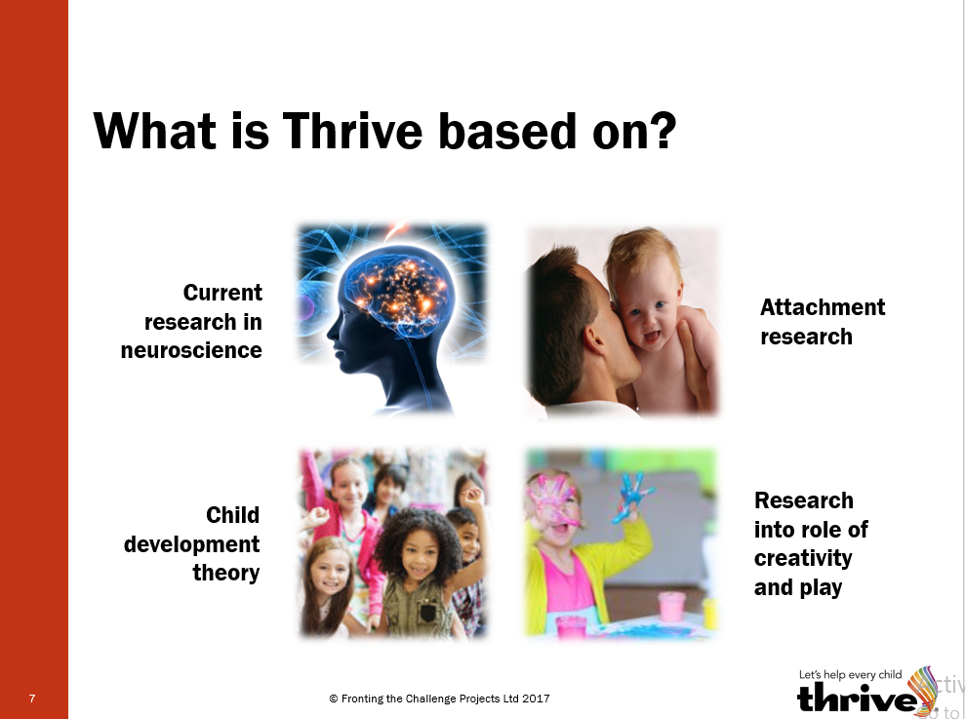
What is the Thrive Approach?
The Thrive Approach is a dynamic developmental approach to working with children and young people that supports their emotional and social wellbeing as the foundation to improve learning.
The Thrive Approach is based on four areas of research: neuroscience, attachment, child development and creative play.
Thrive was developed in 1994 by a multi-agency team of teacher, former Ofsted inspectors, social workers and therapists.
Thrive is used in a variety of settings by many professionals around the world, supporting more than 330,000 children.

Slide 4
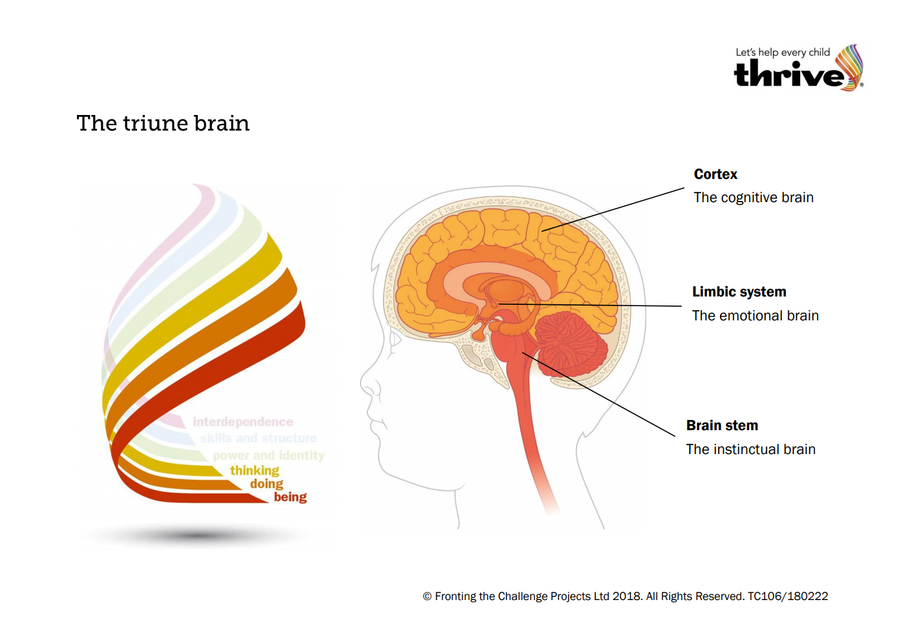
Brain Science – The Triune Brain
The Triune Brain is very simplified model of our brain, highlighting three main areas;
The Brain Stem, often referred to as the instinct brain or reptile brain. This is the first part of the brain to develop and tells us to breath, sleep, hunger etc. It will also tell us to “Fight, Flight or Freeze” when danger is detected.
The Limbic System, otherwise known as the emotional brain or mammal brain. These are where our earliest, none-visual memories are stored and where our emotions are triggered.
The Cortex is our cognitive or thinking brain, it is what makes us human - being able to analyse and gain perspective before making a decision.

Slide 5

What happens to our brain when we ‘blow our top’?
We all know that feeling when we have just had enough and we ‘blow our top’ and lose it. It happens to us all! We’ve had a bad day and that one little thing is just too much!!!!
What is interesting is at this point, our cortex (thinking brain) physically detaches from the rest of our brain, flicking up, and leaving our limbic system (emotions) or even brain stem (flight, fight or freeze) to react.
This is why we see such extreme emotive reactions in our children, who are less able to self-regulate and have a less advanced stress-regulation system to be able to deal with the situation.

Slide 6
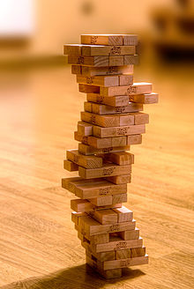
So…what does Thrive do to help with this?
Think of your child’s stress-regulation system as a Jenga block tower. All of their early experiences, relationships and interactions have contributed to the foundations of the tower. Every tower will be different but some will be more wobbly than others (I’m sure at the moment all of our towers are very wobbly!).
Each event which is stressful for a child, removes a Jenga block. This could be a new baby, a death in the family, child starting school, a change in the family home, moving house. Let us emphasise here that everybody has missing blocks in their Jenga tower – this is life.
Thrive supports children to rebuild the missing blocks, from bottom up, developing stronger foundations for resilience and teaching children the language and skills to support their emotional wellbeing.

Slide 7


Thrive in school
At Bilsthorpe Flying High Academy we provide a Whole School Thrive Approach; all children will benefit from Thrive.
We use the online Thrive Approach toolkit to profile every class. This not only highlights any children who may need more intense support but also indicates how the class are developing and feeling as a whole, enabling the teacher to deliver specific activities to support children in the moment.
Our licensed practitioners are then able to deliver more specialised and intense support to those children who need this. Support may be offered through small group or 1:1 work and may be delivered for a short period of time or to support longer term.

Slide 8




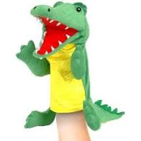
What does Thrive look like in practice?
Thrive in practice incorporates building strong, safe relationships with the child and using creative (and often messy!) play to explore sensations and emotions. This will often include exploring alongside a child, having no-expectations/outcomes for an activity, developing language linking body sensation to emotion and allowing a child to communicate through play.
We use paint, sand, water, puppets, shaving foam, glitter, music, drama, dance, nature, baking, junk modelling, story telling, trust games, hide and seek, scavenger hunts, board games, small world play, feathers, hand cream and even tea bags!

Slide 9
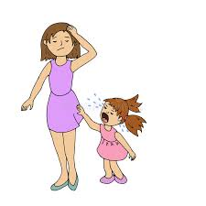
We also use specific language to ensure we validate a child’s emotions, separating the emotion from the behaviour, attune to how they feel, contain their emotion – show that we can bear it and support them through it and finally sooth a child.
Shine a light on the child’s behaviour:
“I imagine you are feeling very angry at the moment because mummy said you cannot go outside in the rain. I understand that you want to go outside and it must be hard for you when I said no. Sometimes I feel angry when I can’t do what I want to do too. However, it is not ok to kick and scream. Even when you are super angry! What can we do next time to help this?”

Slide 10
Why is Emotional wellbeing and resilience so important?
The importance of Mental Health and wellbeing has been highlighted in the news and social media in recent years – especially during the pandemic.
Children with little or no emotional regulation or resilience are unable to engage in learning thus not developing other important skills and knowledge.
Developing emotional wellbeing supports children to develop other skills in communication, sharing, turn taking, participation and patience as well as creating emotional awareness and empathy.
We all want our children to be happy and we all want them to have the best experiences in life. However, we all known life is full of bumps and turns and our children need strong resilience and understanding of their emotional needs to continue to thrive throughout their lives.

Slide 11
Are you interested in using a Thrive approach at home?
Register your interest by emailing
Ms Hinton nhinton@bilsthorpefha.org.
During the Summer Term, we are hoping to offer a 6 week ‘Family Thrive’ course via Microsoft Teams. This course will explain the Thrive Approach in more detail and give lots of support, activities and tips to help you understand and support your child’s emotional development.

