Slide 1

A little about me
This is my 6th year teaching
Taught in inner city Nottingham previously
3rd year teaching Y4 at Bilsthorpe
Previous jobs:
Games tester
Economic development – Mansfield District council and Broxtowe borough Council
Will talk about my cat and my hobbies with class

Slide 2
Who’s who
Mr Topliss – all week
Miss Tuck – TA
Miss Pogmor –Friday PM

Slide 3
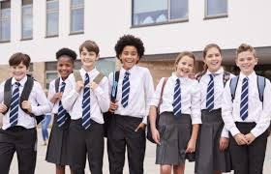
Uniform
Black or grey skirt or trousers
Blue school jumper
Black shoes
PE kit –
Shorts/joggers
Plain white T-shirt
Plain jumper/ school jumper when colder
Plimsols or trainers

Slide 4
What my expectations of the class are:
Fun
Jokes
Be genuine selves
Learning together
Respectful of everyone
Try their best
Make mistakes
Learn from these mistakes
Listen
Presentation of work

Slide 5
What we will be learning?
We will focus on fronted adverbials
Speech and the punctuation related to that.
Use of conjunctions
Co-ordinate – and, but
Subordinate – because, after, before
Spellings
Creating narratives, newspaper reports and poems.

Slide 6
What we will be learning?
Place value to 10,000
Addition, subtraction, multiplication and division of 4 digits.
Area of shapes
Fractions
Decimals
Multiplication and division

Slide 7
Enquiry
Is it only when we govern ourselves that we are well governed?

Slide 8
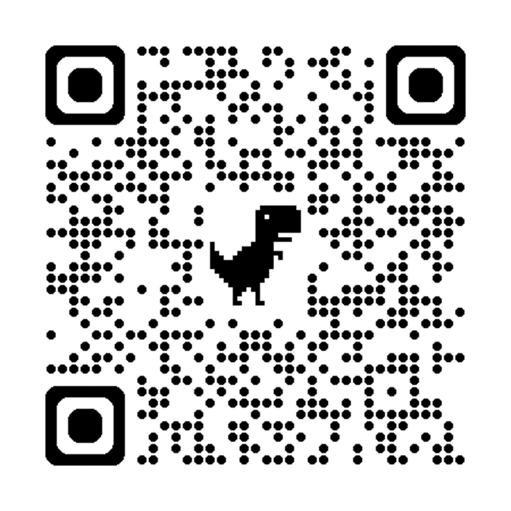
Multiplication check
In the summer term Y4s will have a multiplication test.
It will be completed on ipads.
They have 25 questions, with 6 seconds for each question.
1 – 12 times table.
I want pupils to achieve the best they can do.

Slide 9
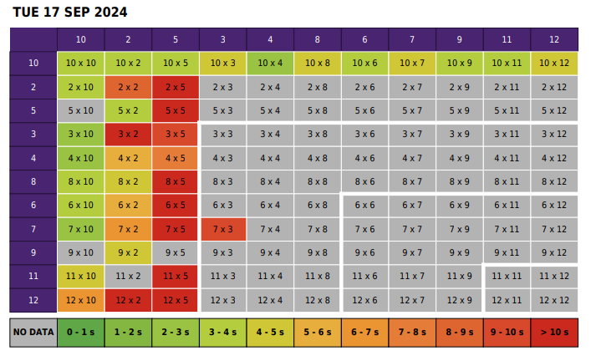
Multiplication check

Slide 10
At home, if possible
Read on a regular basis – 4 times a week
Times tables – this is a big one – logins are in their diaries.
Use of TTRS and the website to help your child with their times tables.

Slide 11
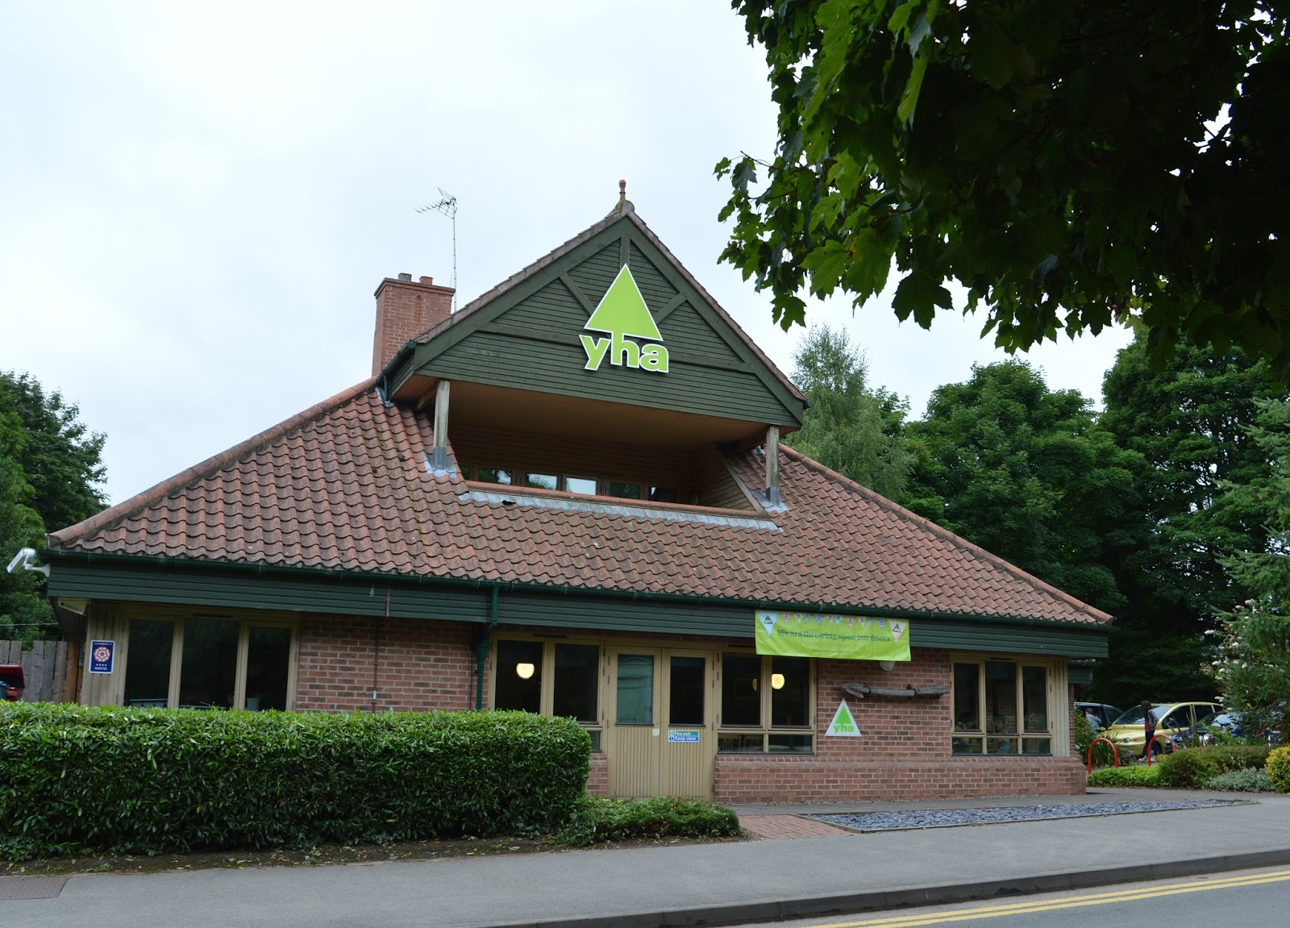
Y4 Residential
Going to Sherwood Forest
Monday 5^{h} July 2027 – Wednesday 7th July 2027
Price TBC
Letters will be sent out in due course regarding this

Slide 12
Any questions?

