Slide 1
Welcome To Year 5

Slide 2
Curriculum
Enquiry question- “Is invasion always a negative experience?” We will learn about the Anglo-Saxons and will make our own weapons as our DT link to the history driver.
English units link to enquiry driver- narrative, information, newspaper report, persuasion.
Maths- place value (up to 1,000,000), column addition and subtraction, decimals and percentages, fractions, perimeter and area including compound shapes, shape, position and direction (coordinates), negative numbers, converting units, volume, statistics.

Slide 3
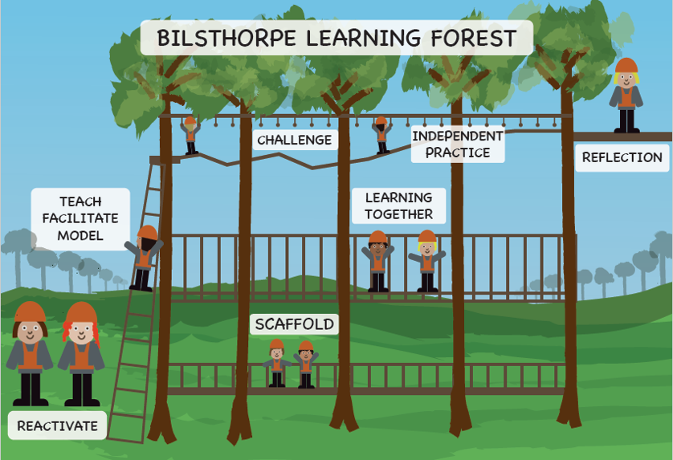

Slide 4
REading
We will be using orbital reading- sequence for teaching and learning vocabulary skills, comprehension, retrieval, summarising, prediction and inference.
Please sign reading diaries every time your child has read at home. Children who read more with an adult make accelerated progress in all areas of the curriculum.

Slide 5
Homework
Reading at home
Either Maths or English task on Friday. which will be to consolidate what we have been covering in school or SPAG revision. This will be due the following Friday.

Slide 6
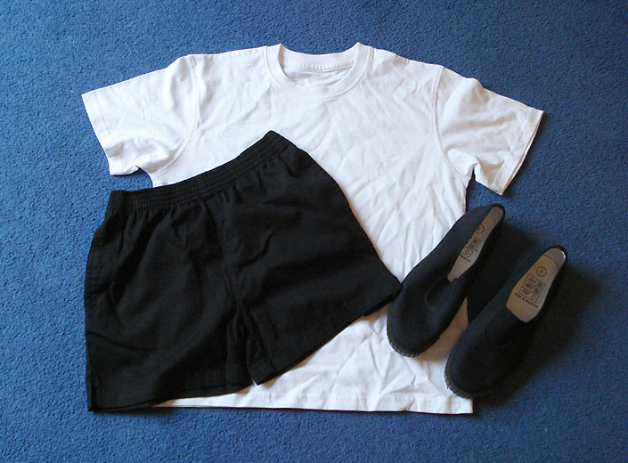
PE kit
White t-shirt
Black or navy blue shorts trainers or black pumps

Slide 7
Preparation for sats
We revise regularly e.g arithmetic sessions to give children a chance to prepare for year 6.
Mathsbot sheets- can access at home (give demonstration).
Get used to limited timings
Boost scores ready to give your child the very best chance in their sats.

Slide 8
Screen time
Government advice is to limit screen time as much as possible.
Educational apps
Monitor screen time at home
Set a limit- especially close to bed time to allow your child to get plenty of rest for learning
Make plans for alternative activities e.g. reading, crafts, outdoor exercise
Take devices off children at night

Slide 9
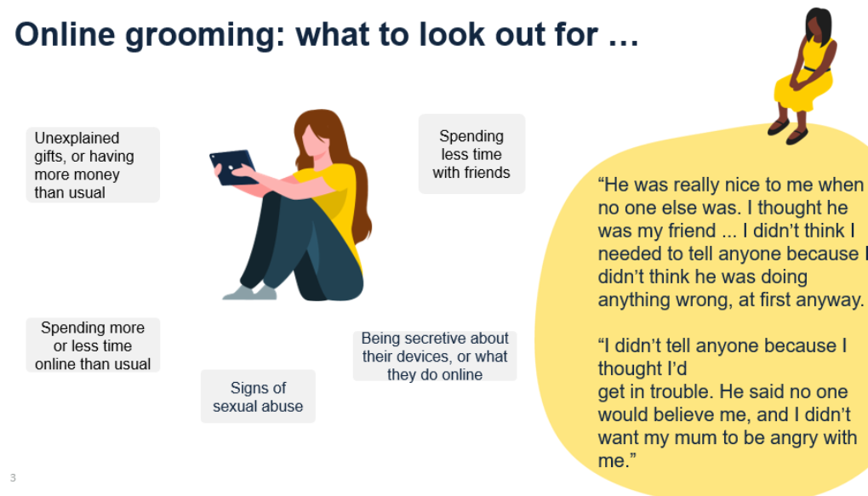

Slide 10


Slide 11
Walking home
Please sign a form in the office to give permission for your child to walk home.

Slide 12

Questions
Dojo availability
Face to face meetings

