Slide 1


Welcome to Year 5

Slide 2
Year 2 Team
Mrs Atkin– Class Teacher (Mondays and Tuesdays)
Miss Onorati (Wednesday ,Thursday and Friday)
Miss Boaler– Teaching Assistant
/Miss Cox – Pupil Support Assistant

Slide 3
Our Curriculum
Our curriculum is still the same style as we had last year.
Each term we have an enquiry question which all of our enquiry lessons link to.
This term ours is ‘Are accidents ever faultless?’ This is based around history and we are learning about The Great Fire of London in 1666.
We will link our DT to our enquiry making Tudor Houses and we will revisit our geography from last year looking at our capital city, locating London on the map and discussing where it is in relation to Bilsthorpe.

Slide 4
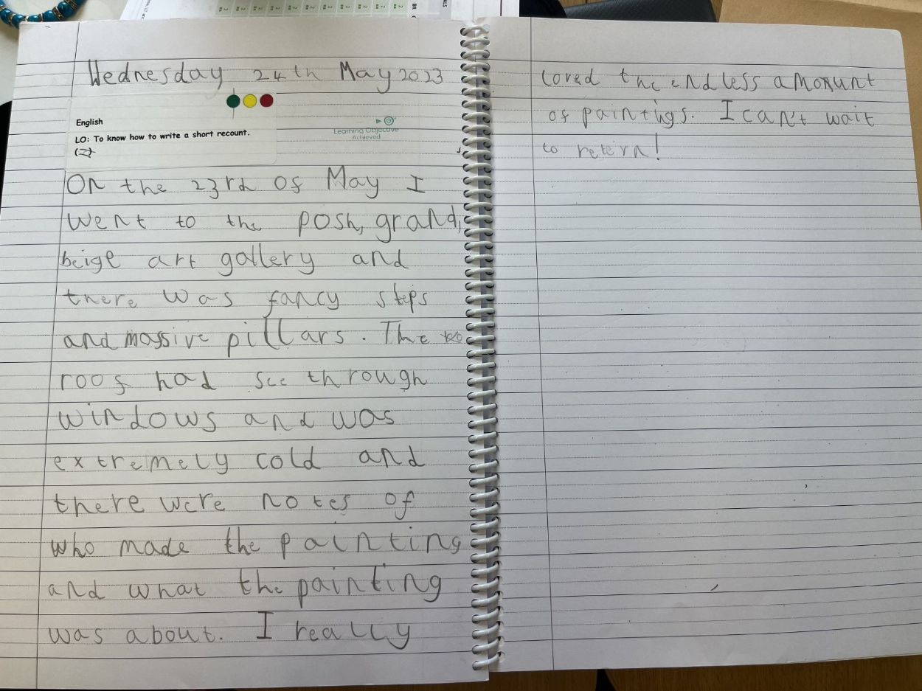
Year 2 expectations
The expectations in Year 2 are a significant step up from Year 1. Here are some pictures of some writing at the expected level for the end of Year 2.

Slide 5
Reading
We are continuing with phonics within the Autumn Term and will continue to revisit the sounds we covered last year and in depth look at different codes that make the same sound.
We will also be doing something called Launchpad Reading which is whole class reading to build up their word reading, fluency, vocabulary and comprehension.
Please sign reading diaries every time your child has read. Reading ladder is 24 however those children who are reading more at home last term made accelerated progress.
Every week we will check reading records for reading and parent/guardian signatures count them and sign the diary each time they read at school.
Some children will get the opportunity to read to a year 5/6 pupil as a buddy in assembly time so you may see their signatures in pencil.

Slide 6
Homework
Reading at home
Spellings will be posted on Dojo to practice.
Enquiry showcase – this is their creative homework which can be completed throughout the term.
Maths – I will post a one minute task on Dojo from the White Rose Maths scheme we follow.

Slide 7
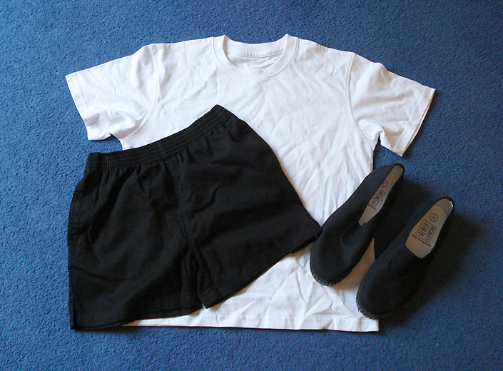
Physical Education
Tuesday and Friday – however this can change.
White T-shirt
Black or navy blue shorts
Trainers or Black pumps

Slide 8

Any Questions?
Parental involvement

