Slide 1
Year 1
Phonic Screening Check
Parent Information april 2026

Slide 2
What is the phonic screening check?
The phonic screening check is an assessment that is carried out for all pupils in Year 1, nationally.
It takes place the week commencing 8th June 2026.
The same test is used for all pupils throughout the country.
Year 1 staff will carry out the test in a familiar room.
The PSC is an assessment tool to see how well a child can apply their phonic knowledge to read words.
It consists of 40 words, real and nonsense.
Parents will be informed how their child did in the end of year report.

Slide 3
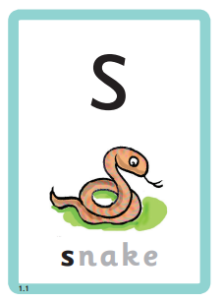

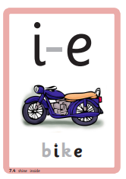

Key Vocabulary
Code – the letter or groups of letters that are written down that form a particular sound i.e. This is letter is the code for the sound …
Sound – the sound a letter or group of letters makes, in the alphabetic code
Alphabet - consists of 26 letters, 5 vowels and 21 consonants. These are often referred to by their name

Slide 4
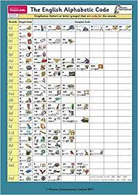
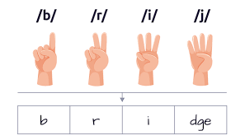


Key Vocabulary
Alphabetic Code – this refers to the sounds the letters make. There are over 40 alternative sounds. Some different groups of letters can make the same sound i.e. ee as in s-ee, e as in h-e, ea as in b-ea-ch, e-e as in P-e-t-e, y as in s-u-nn-y
Segment – to split a word into the different sounds, used when spelling
Blend – to blend together the different sounds, used when reading

Slide 5
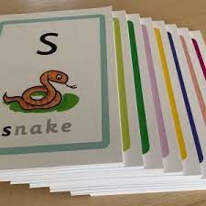
alphabetic code
During phonic sessions, we provide many opportunities to revisit previous sounds learnt. We focus on saying the pure sounds using my turn, your turn.
Let’s have a go and see what we know:
Flashcards
Say the sounds
Fastest finger – show me …

Slide 6
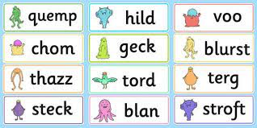
Phonic Screening check
The test consists of 40 words, that the children can use their phonic knowledge to segment and blend.
20 words are real words.
20 words are nonsense words, also known as alien words. They are shown with an alien image to support the children.
These words do not make sense and therefore have no meaning in a sentence.
The alien words test solely their phonic knowledge.
As the children progress through the test the words become longer and use more complex sounds.

Slide 7
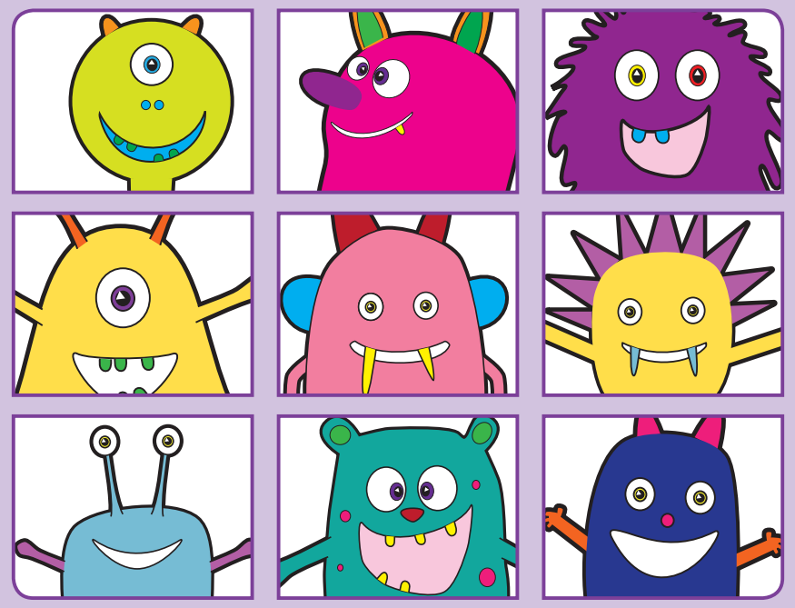

Let’s have a go

Slide 8

Let’s have a go

Slide 9

Let’s have a go

Slide 10

Let’s have a go

Slide 11

Let’s have a go

Slide 12

Let’s have a go

Slide 13

Let’s have a go

Slide 14

Let’s have a go

Slide 15

Let’s have a go

Slide 16

Let’s have a go

Slide 17
How Are we helping your child to succeed?
Complete daily phonic sessions, including revisit of previously taught sounds
Phonic sessions revising tricky sounds are completed in addition
1-1 reading sessions
Practising past phonic screening checks
Phonic interventions and boosters for specific children identified for further support

Slide 18
How can you help your child to succeed?
Regularly, read at home your child’s decodable reading book – these are specifically chosen to match your child’s phonic knowledge
Practise the mini stories sent home, these link to the new codes taught
Practise the say the sounds sheets – sent home
QR codes sent home to practice blending
Play phonic games on the internet such as
https://www.phonicsbloom.com/
https://www.phonicsplay.co.uk/ (work within phase 5 for all sounds)

Slide 19

Do you have any questions?

