Slide 1
Welcome To Year 5

Slide 2
Curriculum
Enquiry question- “Is invasion always a negative experience?” We will learn about the Anglo-Saxons and will make our own weapons as our DT link to the history driver.
English units link to enquiry driver- narrative, information, newspaper report, persuasion.
Maths- place value (up to 1,000,000), column addition and subtraction, decimals and percentages, fractions, perimeter and area including compound shapes, shape, position and direction (coordinates), negative numbers, converting units, volume, statistics.

Slide 3
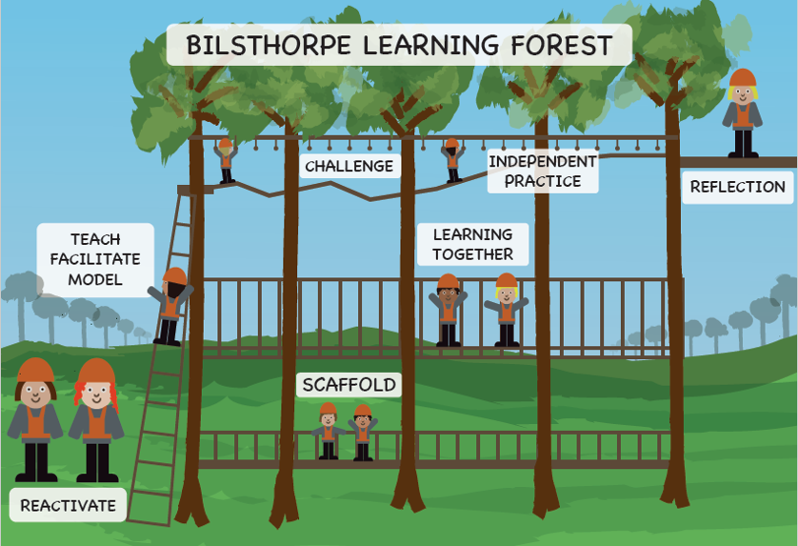

Slide 4
REading
We will be using orbital reading- sequence for teaching and learning vocabulary skills, comprehension, retrieval, summarising, prediction and inference.
Please sign reading diaries every time your child has read at home. The reader ladder reward is for 24 reads, however, children who read more at home often make accelerated progress.

Slide 5
Homework
Reading at home
Spellings given on a Monday along with a homework task to support your child to learn their spellings at home. This is due on the Friday of that week.
Either Maths or English task on Friday. which will be to consolidate what we have been covering in school or SPAG revision. This will be due the following Friday.

Slide 6
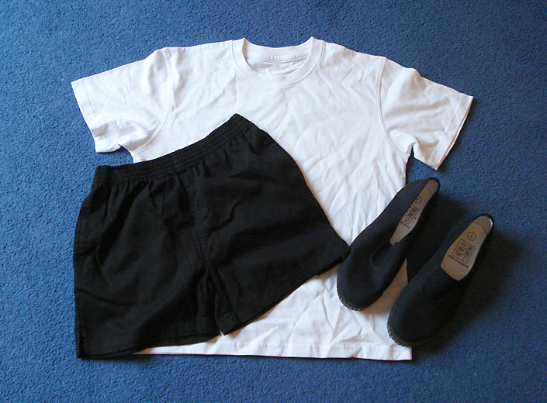
PE kit
White t-shirt
Black or navy blue shorts trainers or black pumps

Slide 7
Ukulele lessons
This year we will be having ukulele lessons once a week- autumn term

Slide 8
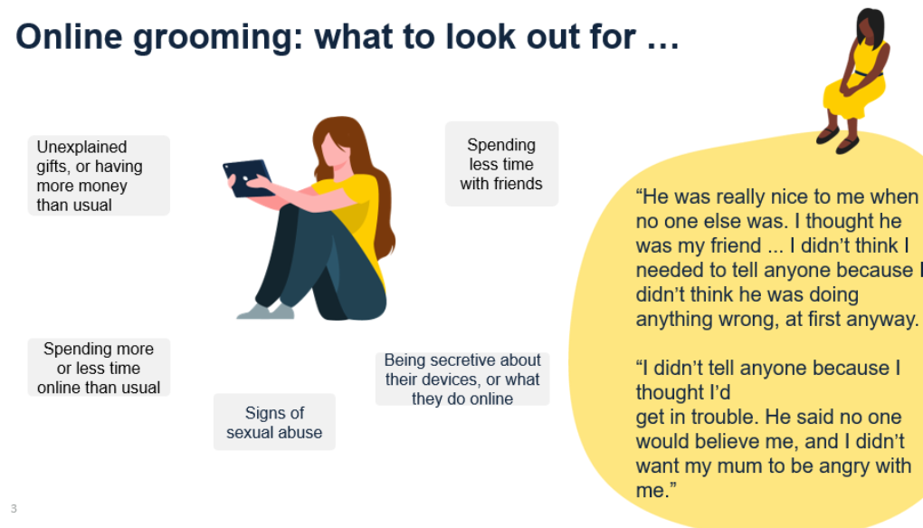

Slide 9


Slide 10

Questions
Dojo availability
Face to face meetings

