Slide 1

A little about me
This is my 5th year teaching
Taught in inner city Nottingham previously
2nd year teaching Y4 at Bilsthorpe
Previous jobs:
Games tester
Economic development – Mansfield District council and Broxtowe borough Council
Will talk about my cat and my hobbies with class

Slide 2
Who’s who
Mr Topliss – all week
Mr Poxon – Wednesday PM
Miss Smith – Wednesday PM

Slide 3

Online grooming
Grooming involves someone building a relationship with a child
and gaining their trust, in preparation for abuse
Online platforms make it easier for groomers to target several
children at once, which can make the grooming process quicker
After making contact online, a groomer may convince a child to meet in person or persuade them to take part in online sexual activity
What is it?
Who is at risk?
Grooming can affect any child, regardless of age, gender, race or socio-economic background
However, some children are more vulnerable than others
© The Key Support Services Ltd | For terms of use, visit thekeysupport.com/terms
Notes:
3

Slide 4
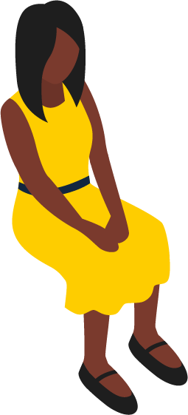


Online grooming: what to look out for …
Spending less time with friends
Unexplained gifts, or having more money than usual
“He was really nice to me when no one else was. I thought he was my friend ... I didn’t think I needed to tell anyone because I didn’t think he was doing anything wrong, at first anyway.
“I didn’t tell anyone because I thought I’d
get in trouble. He said no one would believe me, and I didn’t want my mum to be angry with me.”
Spending more or less time online than usual
Being secretive about their devices, or what they do online
Signs of sexual abuse
Notes:
4

Slide 5
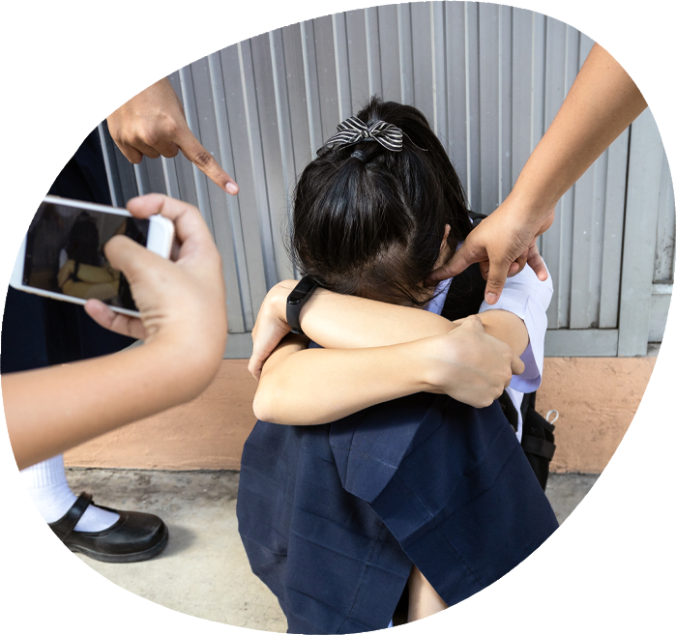
Bullying, including cyberbullying
Bullying is behaviour by an individual or group, repeated over time, that intentionally causes physical or emotional harm, or both.
It can happen in person or online, both in and out of school, and can
be prejudice-based or discriminatory.
Notes:
5

Slide 6
What are the warning signs?
Not wanting to go to school or feeling ‘ill’ every morning
Physical injuries
Belongings getting ‘lost’ or damaged
Not doing as well at school
Being nervous, losing confidence, or becoming distressed and withdrawn
Being nervous or secretive when using their mobile phone or computer
Problems with eating or sleeping
Bullying behaviour towards others
Notes:
6

Slide 7
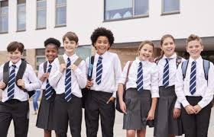
Uniform
White t-shirt or shirt
Black or grey skirt or trousers
Blue school jumper
Black shoes
PE kit –
Shorts/joggers
Plain white T-shirt
Plain jumper/ school jumper when colder
Plimsols or trainers

Slide 8
What my expectations of the class are:
Fun
Jokes
Be genuine selves
Learning together
Respectful of everyone
Try their best
Make mistakes
Learn from these mistakes
Listen

Slide 9
What we will be learning?
We will focus on fronted adverbials
Speech and the punctuation related to that.
Use of conjunctions
Co-ordinate – and, but
Subordinate – because, after, before
Spellings
Creating narratives, newspaper reports and poems.

Slide 10
What we will be learning?
Place value to 10,000
Addition, subtraction, multiplication and division of 4 digits.
Area of shapes
Fractions
Decimals
Multiplication and division

Slide 11
Enquiry
Is it only when we govern ourselves we are well governed?

Slide 12
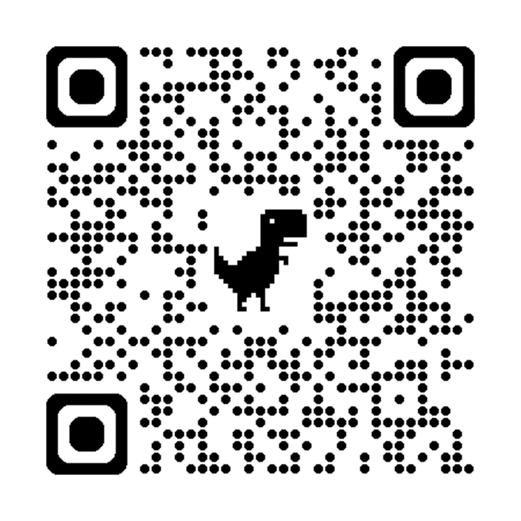
Multiplication check
In the summer term Y4s will have a multiplication test.
It will completed on ipads.
They have 25 questions, with 6 seconds for each question.
1 – 12 times table.
I want pupils to achieve the best they can do.

Slide 13
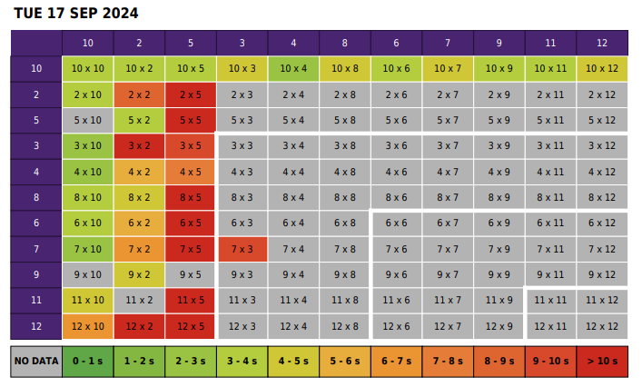
Multiplication check

Slide 14
At home, if possible
Read on a regular basis – 4 times a week
Times tables – this is a big one – logins are in their diaries.
Use of TTRS and the website to help your child with their times tables.
Spellings – have children practise once or twice a week. Spell out loud and on paper. We will have a test most Fridays.

Slide 15
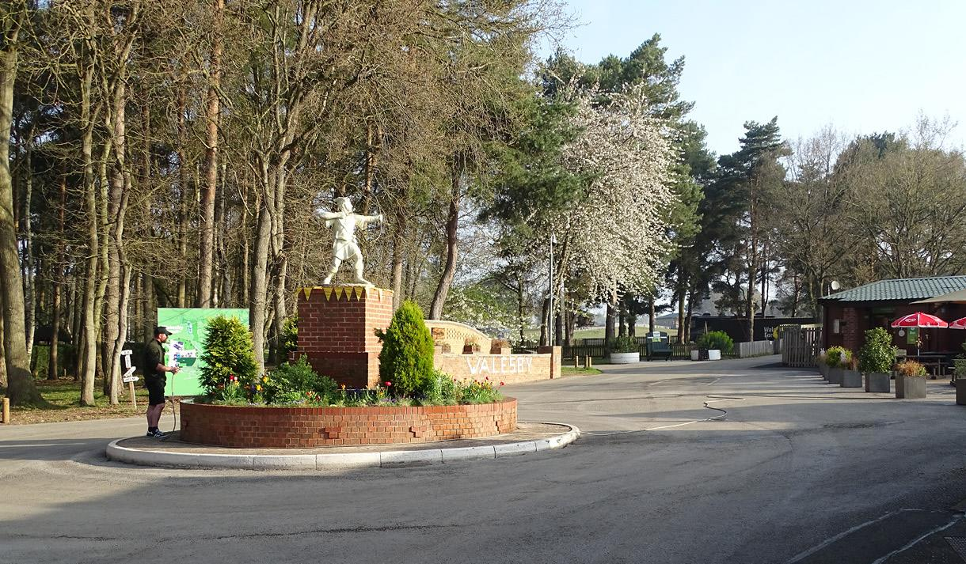
Y4 Residential
Going to Walesby Forest
Monday 6th July 2026 – Wednesday 8th July
Price TBC
Letters will be sent out in due course regarding this

Slide 16
Any questions?

